Slide 1
Build Tools

Slide 2
What is Maven?
Maven is a Software project management and comprehension tool
Based on the concept of a Project Object Model (POM)
Maven can manage a project’s build, reporting and documentation

Slide 3
Why Maven?
When building a java project it requires
Add additional jar files like Spring, Hibernate, JSON etc
One approach is to download the JAR files from each project web site
Manually add the JAR files to your build path or classpath

Slide 4
Without Maven
Spring JAR Files
Application
Spring
Hibernate
JSON
…..
Hibernate JAR Files
Developer
Apache Commons
JAR Files
JSON JAR Files

Slide 5
Maven solution
Tell maven the projects you are working with (dependencies) like spring, hibernate
Maven will add all jar files required for project

Slide 6
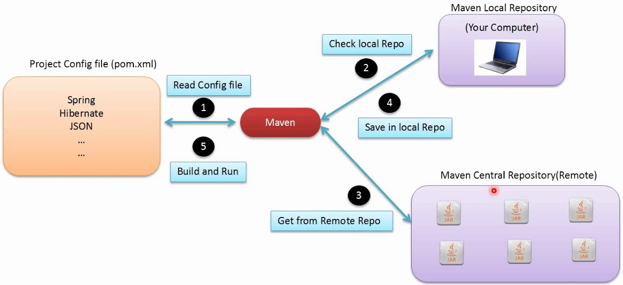
How Maven works

Slide 7
Handling JAR Dependencies
Based on config file, Maven will add JAR files accordingly
When Maven retrieves a project dependency
Downloads supporting dependencies
Maven will handle this for us automatically

Slide 8
Archetype
A template of a project which is combined with some user input to produce a working Maven project that has been personalized to the user’s requirements
There are hundreds of archetypes to help us get started

Slide 9
Plugins
A plugin provides a set of goals that can be executed to perform a task
There are Maven plugins for building, testing, source control management, running a webserver, generating Eclipse project files, and much more
Some basic plugins are included in every project by default, and they have sensible default settings

Slide 10
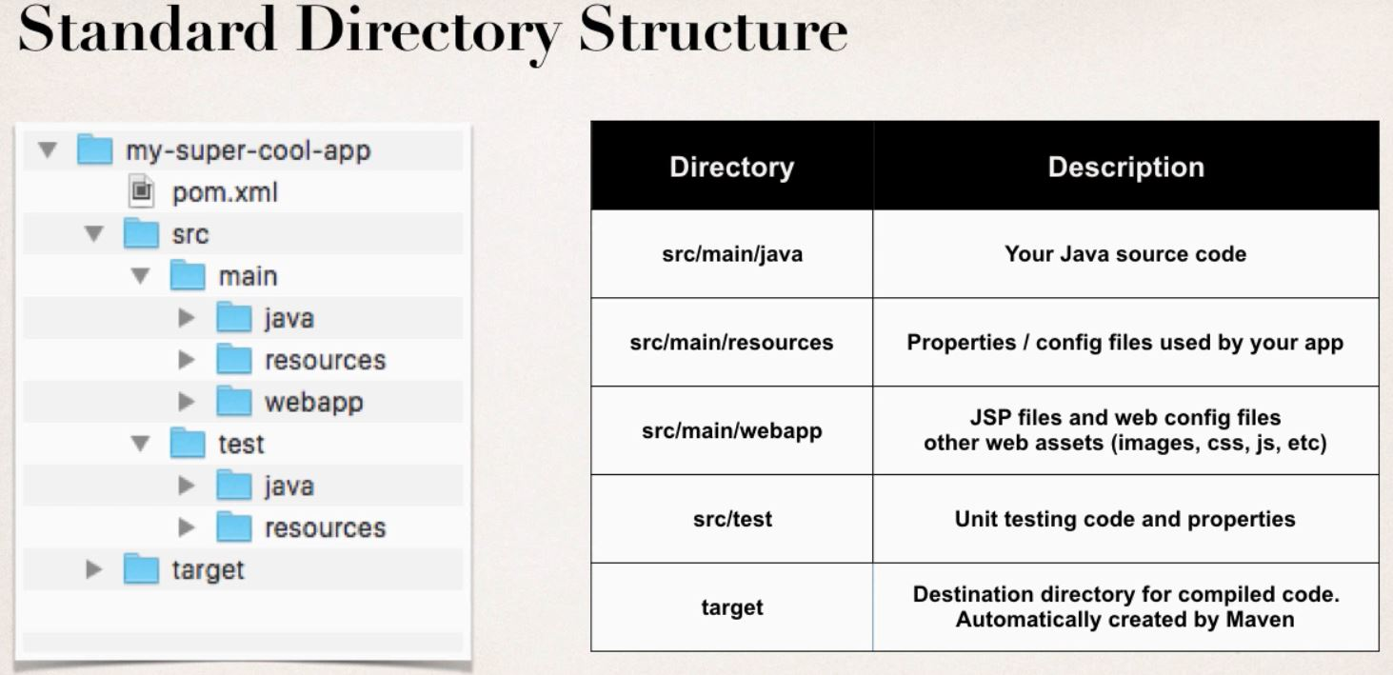
Standard Directory Structure
Source: https://sites.google.com/site/mytechnicalcollection/programming/java/spring/maven

Slide 11
Advantages
Novice user can easily find code, properties files, tests, web files etc
Many IDE’s have built-in support for Maven
Maven projects are portable
Dependency Management
Standard Directory Structure
Building and running the project. No more build\classpath issues

Slide 12
POM file
POM: Project Object Model
Fundamental unit of work
Configuration file
XML file contains information about the project and configuration details used by maven to build the project
Located in the root of a project

Slide 13
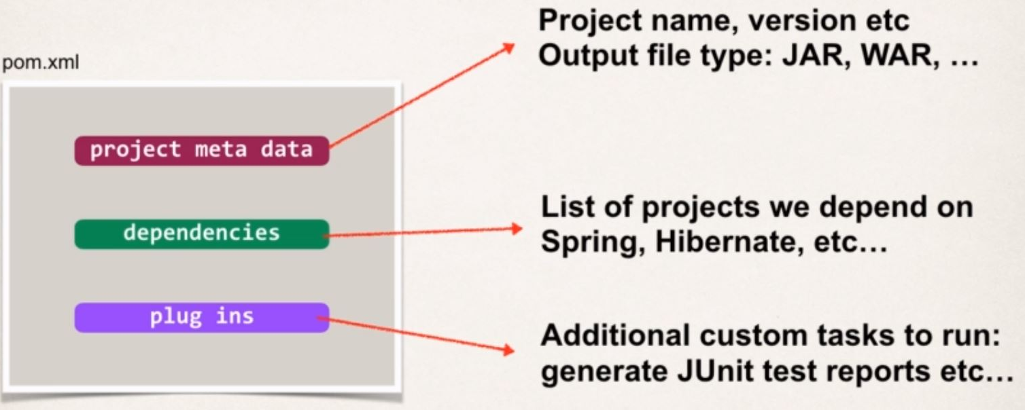
POM File Structure

Slide 14
Project Coordinates
Project Coordinates uniquely identify a project
Elements:
groupId: Name of organization, convention is to use reverse domain name
artifactId: Name of the project
version: A specific release version

Slide 15
Adding Dependencies
To add given dependency, project requires:
Group ID, Artifact ID
Version is optional
Referred as GAV (Group ID, Artifact, and Version)
Dependency co-ordinates could be found at https://search.maven.org

Slide 16
GAV co-ordinates
Group ID:
Its an identifier for a collection of related modules.
Usually a hierarchy that starts with the organization that produced the modules, and then possibly moves into the increasingly more specialized projects
Artifact:
It’s a unique identifier or a simple name that is given to a module within a group
There can be multiple modules in a group
e.g. If group has module webapp, its artifactID: “webapp”

Slide 17
GAV co-ordinates
Its an identifier for the release or build number of project and there are two types:
Releases: a version that is assumed never to change. Only to be used for a single state of the project when it is released and then updated to the next snapshot
Snapshot: used during the development as it implies that development is still occurring that project may change

Slide 18
Project Coordinates (Cont.)
Minimal pom.xml Example
<project>
<modelVersion>4.0.0</modelVersion>
<groupId>org.springframework</groupId>
<artifactId>spring-context</artifactId>
<version>5.0.0.RELEASE</version>
</project>

Slide 19
Build Life-Cycle
Commonly used life-cycle phases in default life-cycle:
Validate: checks build prerequisites
Compile: compiles the source code identified for the build
Test: runs unit tests for the compiled code
Package: assembles the compiled code into binary build results
Install: shares the build with other projects on the same machine
Deploy: published the build into a remote repository for other projects to use

Slide 20
References
https://www.udemy.com/course/spring-hibernate-tutorial/
https://sites.google.com/site/mytechnicalcollection/programming/java/spring/maven
http://maven.apache.org/guides/getting-started/index.html#What_is_Maven
https://www.slideshare.net/sandeepchawla/maven-introduction

Slide 21
Build Tools
The End

